Slide 1
An Introduction to Database
Introduction to Database for Undergraduate Study
Lecture 4
Relational Model
Normalization
ER Diagram
ER to Relational Database
This lecture and its associated materials have been produced by Mr. Rohit Panday (M.Sc. IT, 10+ Years of Industry/Academic Experience) of iAcademy for the purposes of lecturing on the above described subject and the material should be viewed in this context. The work does not constitute professional advice and no warranties are made regarding the information presented. The Author and iAcademy do not accept any liability for the consequences of any action taken as a result of the work or any recommendations made or inferred. Permission to use any of these materials must be first granted by iAcademy.

Slide 2
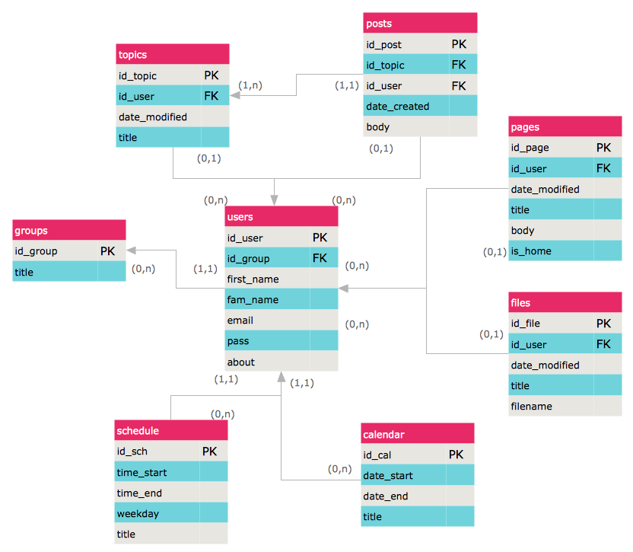
Entity Relationship Diagram
A Collection of relations is called DATABASE.
The organization of data into collections of two dimensional tables called RELATIONS

Slide 3
Reminder – Last Week
What is Relational Model ?
What is Entity and Attribute ?
What are Constraints ?
What is importance of Level of Abstraction ?

Slide 4

Agendas – This Week
Relational Model
Database Design Process
  Normalization
  Relational Model
ERD Components
  Entity
  Attributes

Slide 5
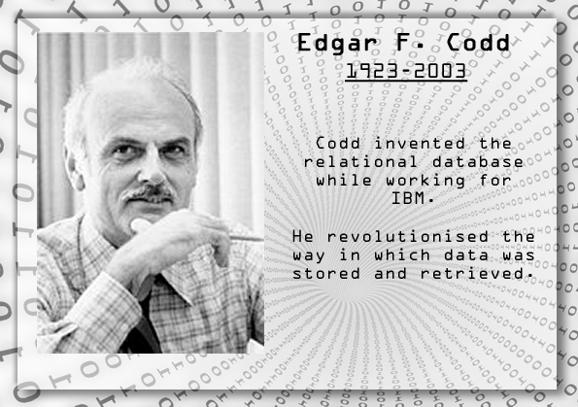
Relational Model
The relational model is the conceptual basis of relational databases. Proposed by E.F. Codd in 1969, it is a method of structuring data using relations, which are grid-like mathematical structures consisting of columns and rows.
Edgar Frank "Ted" Codd was an English computer scientist who, while working for IBM, invented the relational model for database management, the theoretical basis for relational databases

Slide 6
Database Design Process
Relational Model
Top Down Approach
Entity - Attributes
Normalization
Bottom Up Approach
Attributes - Entity

Slide 7
Normalization
3NF
2NF
UNF
1NF
Normalization is the process of efficiently organizing data in a database
Best, when you have set of attributes in form of Entry Forms or Reports
Process of Identifying Entities from given set of Attributes

Slide 8
Normalization - Process
1NF
Remove Repeating Values
2NF
Remove Partial Dependency
3NF
Remove Transitive Dependency

Slide 9
Relational Model – Design Process
Step 1
Identify Entities
Step 2
Identify Attributes and Keys
Step 3
Determine Relationship between Entities

Slide 10
Components of ER Diagram
Entity
[Rectangle]
Attribute
[Oval]
Relationship
[Diamond]

Slide 11
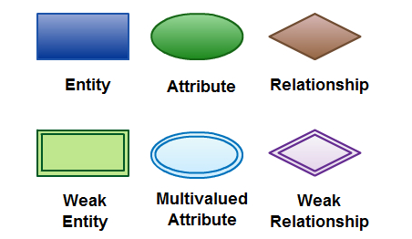
Other Symbols

Slide 12

Entity
Entity
An entity can be a person, place, event, or object that is relevant to a given system
Weak Entity
A weak entity is an entity that depends on the existence of another entity. In more technical terms it can defined as an entity that cannot be identified by its own attributes
The order item will be meaningless without an order so it depends on the existence of order
For example, a school system may include students, teachers, major courses, subjects, fees, and other items
Entities are represented in ER diagrams by a rectangle and named using singular nouns

Slide 13
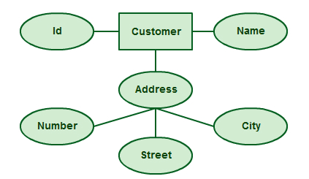
Attribute - Composite
Composite Attribute
Here, ADDRESS is a COMPOSITE ATTRIBUTE containing other THREE ATTRIBUTES Number, Street, City
An attribute is a property, trait, or characteristic of an entity, relationship, or another attribute

Slide 14

Attribute – Multi Value
Multivalue Attribute
Here, SUBJECT can have multiple values like English, Computer, Mathematics etc
An attribute is a property, trait, or characteristic of an entity, relationship, or another attribute

Slide 15
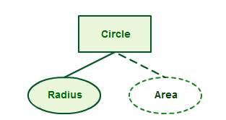
Attribute – Derived
Derived Attribute
Here, AREA can be DERIVED using TADIUS attribute
An attribute is a property, trait, or characteristic of an entity, relationship, or another attribute

Slide 16
Key Points
What is ENTITY ?
What are types of ENTITIES ?
How do you define an ATTRIBUTE ?
How many types of ATTRIBUTES do you remember ?

Slide 17

ERD- Walkthrough
ENTITIES
Let’s take an example of Educational Institution

Slide 18
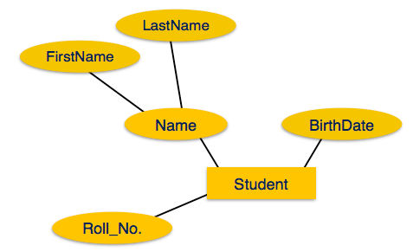
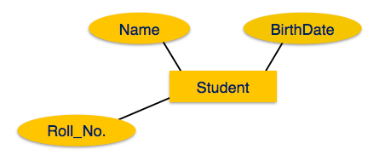
ERD- Walkthrough
ATTRIBUTES
If the attributes are composite, they are further divided in a tree like structure. Every node is then connected to its attribute. That is, composite attributes are represented by ellipses that are connected with an ellipse.
Let’s take an example of Educational Institution

Slide 19
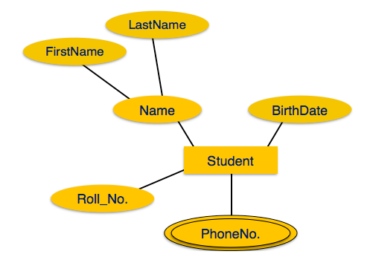
ERD- Walkthrough
ATTRIBUTES
Multivalued attributes are depicted by double ellipse
Let’s take an example of Educational Institution

Slide 20
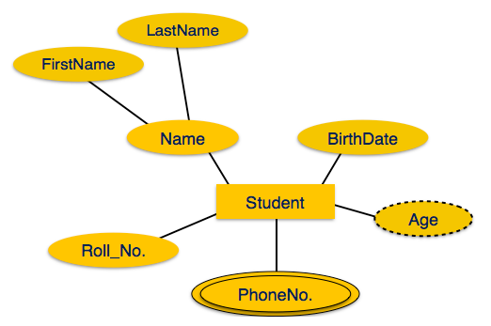
ERD- Walkthrough
ATTRIBUTES
Derived
attributes
are depicted by dashed ellipse
Let’s take an example of Educational Institution

Slide 21
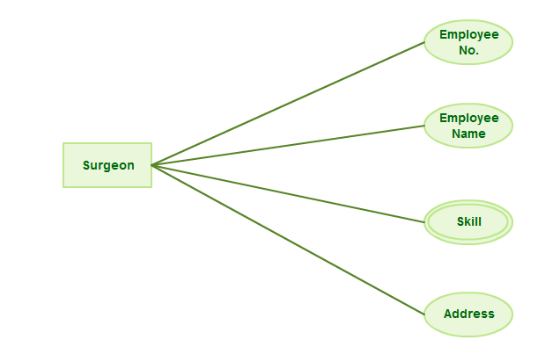
A Basic ERD for Quick Start

Slide 22
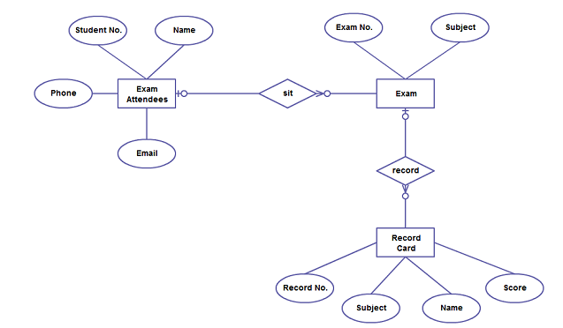
A Basic ERD for Quick Start

Slide 23
Yet Another Example
STUDENT
SUBJECT
One Student Studies Many Subjects
One Subject is Studied by Many Students
Let’s take an example of Educational Institution

Slide 24
Yet Another Example
STUDENT
SUBJECT
One Student Studies Many Subjects
One Student Studies Many Subjects
Let’s take an example of Educational Institution

Slide 25
Yet Another Example
takes
STUDENT
SUBJECT
One Student takes Many Subjects
One Subject is taken by Many Students
Let’s take an example of Educational Institution

Slide 26
Key Points
Entity
Attributes
Constraints
Relationships
Entity Relationship Diagram

Slide 27
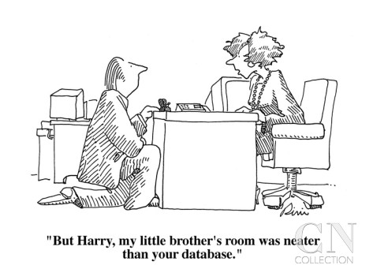
Laugh

Slide 28

End of Lecture for Week - 4

